Slide 1

Block Escape
André Sousa (up202005277@fe.up.pt)
Gonçalo Pinto (up202004907@fe.up.pt)
Pedro Fonseca (up202008307@fe.up.pt)
AI First Project

Slide 2
Software used and related work
Stuart Russell, Peter Norvig; Artificial intelligence. ISBN: 978-0-13-207148-2
Richard S. Sutton; Reinforcement learning. ISBN: 978-0-262-03924-6
Stuart Russel, Peter Norvig; Artificial Intelligence: A modern Approach.
https://www.transum.org/Maths/Investigation/CarPark/
PyCharm Professional
Python 3.9
Git

Slide 3
Specification of the work
Goal: take the red piece to the exit, while navigating around obstacles on a limited grid.
Project Objectives:
Implement search algorithms to efficiently calculate an efficient path to the exit.
Test and analyze various algorithms and heuristics to determine the best approach for the game.
Algorithms: breadth-first search, depth-first search, iterative deepening, uniform cost, greedy search, A* algorithm and weighted A*

Slide 4
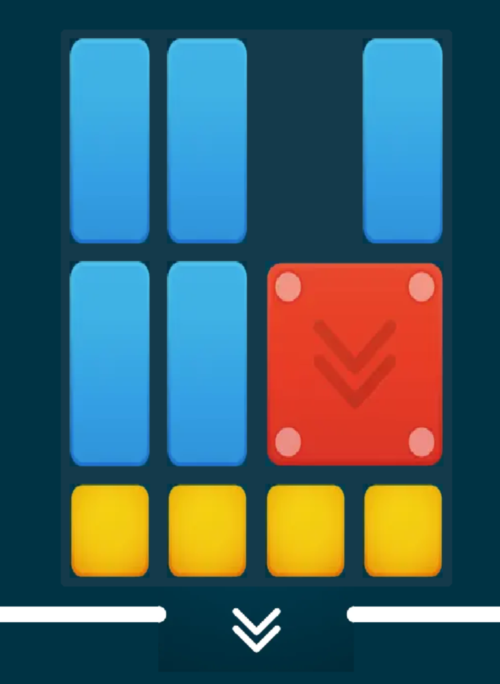
Formulation of the problem as a search problem
Objective Test: Move the red piece out of the board through a series of movements without getting blocked.
State Representation: An object Puzzle with defined dimensions and a list of pieces.
Initial State: A board filled with pieces and the red piece blocked.
Operators: move: Move a piece to an empty space in the game board.
Preconditions: Enough space adjacent to the current position and the coordinate is valid on the game board.
Cost: 1 move.
Effect: Update the position of the piece and end the game if the red piece reaches the exit.
Heuristics:
H1: Distance from the red block to the exit.
H2: Weighted sum of the number of obstacles between the red block and the exit.
H3: The largest contiguous empty space near the red block.
H4: Prioritize moves that keep the red block close to the edges of the game board.
H5: Always ensure that the red block has at least one valid move option available.
H6: Prioritize fitting pieces along the edges of the game board from largest to smallest.
H7: Prioritize moving the largest pieces on the game board first.

Slide 5

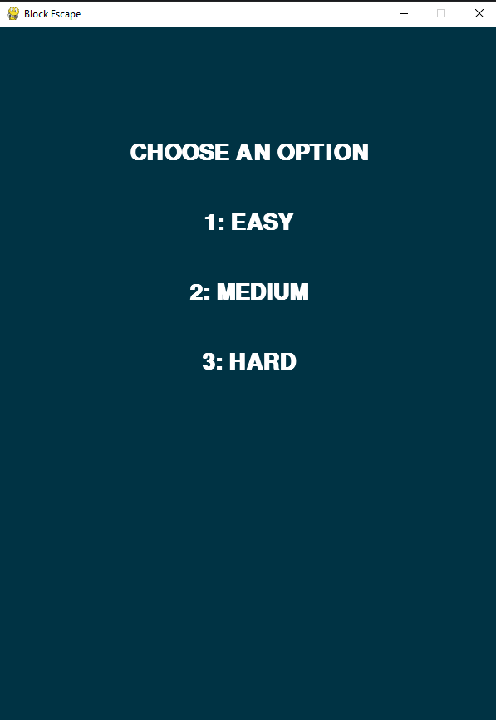
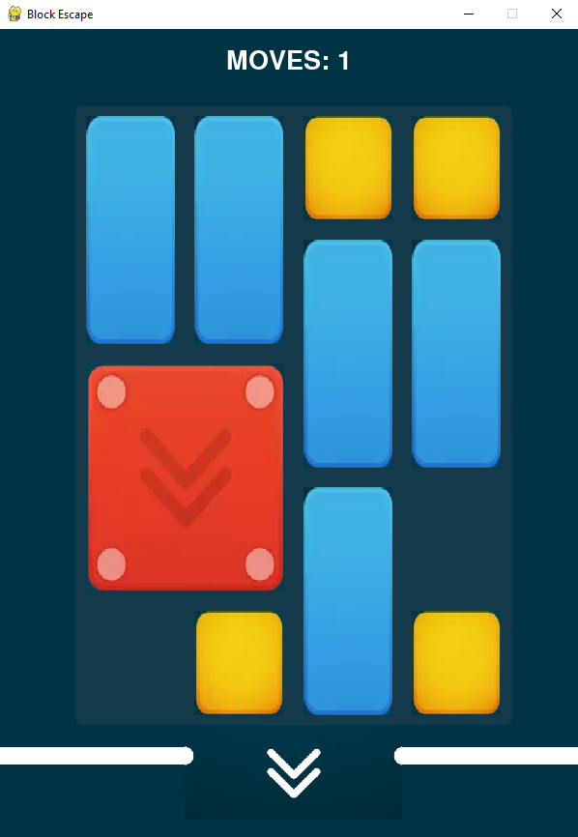
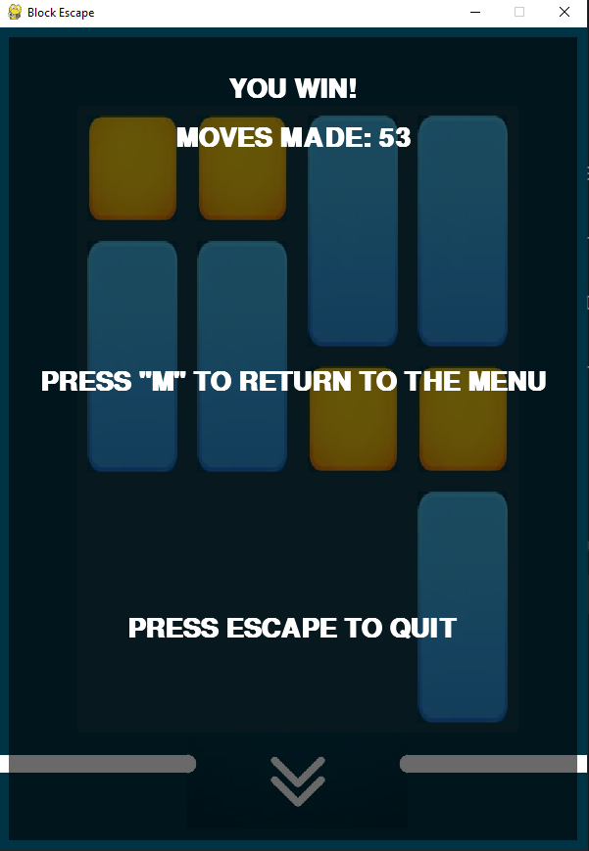
Implementation work already carried out
Menu that allows users to start or quit the game
Difficulty level selection after starting the game
Graphical User Interface (GUI) for piece movements
Game over detection to determine when the game ends
Total moves counter to keep track of the number of moves made

Slide 6
Heuristics and operators
Heuristics:
H1: Euclidean distance between the red block and the exit
H2: Weighted sum of the obstacles between the red block and the exit
H3: Maximize the amount of contiguous empty spaces near the red block
H4: Prioritize moves that keep the red block close to the edges
H5: Prioritize movements in which the red block has at least one possible movement
H6: Prioritize fitting blocks along the edges of the game board from largest to smallest
H7: Prioritize moving the largest blocks first
H8: Prioritize moving the smallest blocks first
Operators:
move: Move a block (up, down, right or left) to an adjacent empty space in the game board.
Preconditions: Enough space adjacent to the current position and the coordinates are valid on the game board.
Cost: 1 move.
Effect: Update the position of the block.

Slide 7

Implemented algorithms
Breadth First Search
Depth First Search
Depth Limited Search
Iterative Deepening Search
Greedy Search
A* search
Weighted A* search

Slide 8
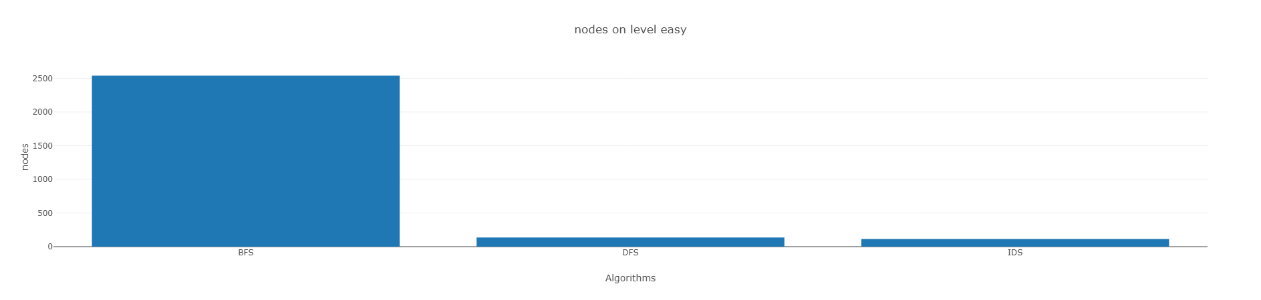
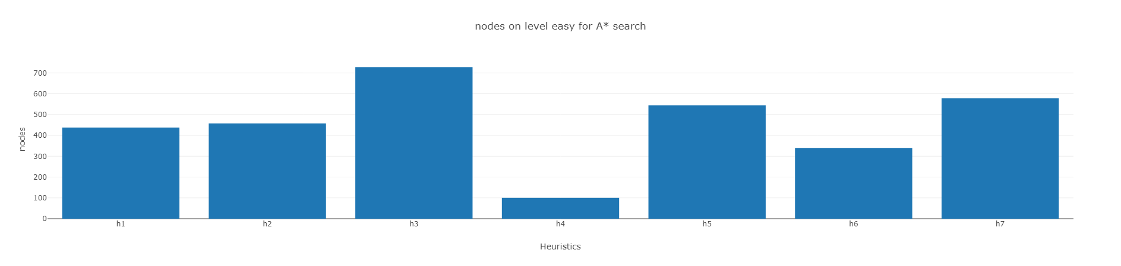
Experimental Results
Full report here

Slide 9
Conclusions
In conclusion, we implemented multiple search algorithms in our game "Block Escape", including BFS, DFS, IDS, A*, Weighted A* and Greedy.
While each algorithm has its strengths and weaknesses, we found that BFS was very slow compared to the other algorithms. Greedy search, on the other hand, performed differently due to its lack of a cost function. When it comes to the heuristics we implemented, we found that prioritizing moves that keep the red block close to the edges of the board was the best heuristic overall. This heuristic consistently outperformed the other heuristics in terms of finding optimal solutions, and we believe this is because it helps the algorithm focus on paths that are more likely to lead to the goal state. In our experiments, all the heuristics provided an optimal solution in the A* algorithm. This shows that the heuristics we chose were effective in guiding the search towards the goal state. Finally, we found that IDS was slower than DFS, but used fewer nodes compared to DFS. This suggests that IDS could be a good choice when memory is a concern, and we recommend considering it as an alternative to DFS in certain scenarios.
Overall, the search algorithms and heuristics in "Block Escape“ performed accordingly to our expectations.

